Slide 1
Incident Response 101
What Happens After the Hack? Presented by
Joshua Morgan
Notes:
Welcome to Blue Team Village’s Project Obsidian : An Introduction to[fill here]

Slide 2
What will we learn?
What Incident Response is.
Terminology used in Incident Response.
Why Incident Response is important.
Where Incident Response fits within an organization.
Resources to learn more.
Notes:
Some things we will cover in this session are some terms that are good to know about when understanding Incident Response.
What Incident Response or Threat Hunting as some call it is.
Why Incident Response is important to an organization or company.
Where does the Incident Response Team fit into a company or organization.

Slide 3
What is Incident Response?
When you look on the internet there are various definitions of Incident Response.
Let's look at what how a common LLM defines Incident Response.

Slide 4

What is Incident Response?
“Incident Response is the structured approach to managing and containing the effects of a security incident.”
“Incident Response is a calculated effort to minimize damage done as a result of an incident combined with efforts to minimize future events/incidents related to the same or similar issues discovered.”
– LLM
Notes:
It is proactive vs incident response is reactive

Slide 5
Incident Response is one of the most IMPORTANT pieces of the Security Puzzle!

Slide 6


Slide 7

Terminology
Let's get started with some terminology and concepts related to the world of
Incident
Response
Notes:
Let's start with some terminology that is good to know when understanding Incident Response. This is not an large list of terms as there are many terms withing Cyber Security / information security. We could spend many hours attempting to cover them all.

Slide 8
Security Incidents?
How do we classify?
Not always defined the same in every organization.
This will depend on your organization’s risk tolerance but typically depends on criteria relevant to the organization.
Issue differs dependent on how the organization defines it.
Security Event/Alert != Security Incident
Never yell “Incident” in a crowded SOC
Notes:
This slide has animations that appear in sequence.

Slide 9
Terminology
Security Event
Any observable occurrence related to the security of a system or network, encompassing both normal activities and potential threats:
Successful or Failed Logon Attempts
Network Changes
Installation of Software on Assets
Notes:
This slide has animations that appear in sequence.

Slide 10
Terminology
Security Incident
A specific type of event indicating a breach, unauthorized access, or significant security issue. This is something that negatively affects an organization.
Ransomware Outbreak
Corporate Data Leak
Website Takeover

Slide 11
Event = Incident?
How do we classify something as an incident?
This will depend on your organization’s risk tolerance but also on criteria relevant to the organization.
Impact
How does the issue affect the organization?
How many users or systems are involved?
What data/information is involved?
Urgency
How critical are the users/assets involved?
How does this affect organizational business continuity?

Slide 12

Why is Incident Response Important?
Incident Response is important for many reasons.
The main reason is because it helps the organization respond and recover from the effects of an event that compromises the security and integrity of an attack.

Slide 13
Why is Incident Response Important?
Need to structure the investigation and associated work
If you have a standardized process, you can replicate it every time.
Know your role...
By implementing Incident Response, each team member knows their role and what to do when called upon.
...and tell the story
Once we run through an IR engagement, we should be able to paint the picture of what happened in the incident.
It strengthens defenses...eventually
After the incident, the team and organization can highlight important lessons learned and implement defensive improvements.

Slide 14

Incident Response:
Who you gonna call?

Slide 15

Who is on the Incident Response Team?
The makeup of the Incident Response Team depends on the makeup of the organization.
Most organizations often have no dedicated Incident Response Team, but instead this team is made up of roles that fill in where is appropriate.

Slide 16
IR Roles
Incident Commander/Incident Response Lead
Security Operations Center (SOC) Manager/Leader
Incident Analysts
SOC Analysts
Legal/Compliance
Governance Team
Legal Team Members
Executive Management
CIO
CISO
External Third-Party IR Support Augmentation
Contracted/Support on Retainer
Communications Team
Public Relations
Marketing

Slide 17


How do we Activate the IR Team?
The Incident Response Team (IRT) is activated based on specific, official criteria that is previously determined by an organization.
An Incident can typically only be declared by the Incident Commander or Incident Response Lead

Slide 18

What does the Incident Commander Do?
The Incident Commander is integral for the implementation and drives the flow of the Incident Response Process.

Slide 19
The Incident Commander
Considered the Leader of the Incident Response Process
Normally responsible for the declaration of an Incident.
The Decision Maker
Makes decisions but often needs approval for some steps.
“I have people skills; I am good at working with people!”
Incident Commanders need to be able to work with a diverse group of individuals, some technical, some not.
Stays Cool, Calm, Collected
The IR Process is stressful – keep your cool to communicate throughout the process.
Who can be an Incident Commander?
SOC Manager/Lead
IT Security Director

Slide 20

What does the Incident Analyst Do?
Another important role of the Incident Response Team is the Incident Response Analyst.
These team members take a deep dive into the details of the incident and try to discover the source of the issue.

Slide 21
The Incident Analyst
The Technical Detectives
Hunting to find the source of the intrusion, leak, or adverse action taken.
Takes Direction from the Incident Commander
Will be assigned tasks and what/where to search based on initial findings.
Shares findings with the IR Team
Should be prepared to speak to their findings to the greater team.
Stays Cool, Calm, Collected
Sound familiar? Yeah, Analysts need to stay calm as well. It’s team work, so don’t stress!
Who can be an Incident Analyst?
SOC Analyst
Helpdesk Analyst
Network Engineer

Slide 22
The Incident Analyst Mindset
Be Responsible, Respectful, Trustworthy.
The Analyst has a significant role in potential disciplinary or legal actions being taken.
Act Fast...
Time is of the essence in Incident Response, so act quickly.
...But Don’t Be Reckless
What you do is important, and accuracy is key.
Trust Your Process
You’ve taken steps to build your Processes and Procedures – trust them to work.
Be confident in your findings
You’re the expert, the Subject Matter Expert, trust your instincts.
Be ready to pivot
One path might not be right, but you can always move on to the next.

Slide 23

Incident Response is a Team Sport?
Incident Response is not something that can or should be done by one person.
IR is a Team Sport and having a well-working team can make the difference in efficiency or chaos.

Slide 24


IR Lifecycle and Frameworks
We will learn about the IR Lifecycle.
We will also learn about IR Frameworks.

Slide 25
Response, Lifecycle, Frameworks – Oh, My!
What is the Incident Response Lifecycle?
How can we apply the Incident Response Lifecycle?
What is an Incident Response Framework?
How can we use an Incident Response Framework?

Slide 26
The Incident Response Framework
Structure for designing your Plan
Provides tried and tested guidance for your Incident Response.
Best Practices
Provides step by step to base your plan on.
Industry-known and accepted
Makes it easier if you need to bring in new team members.

Slide 27
The Incident Response Lifecycle
Guidance on the steps involved in Incident Response
Breaks each item down to specifics.
Defines what happens in each checkpoint of the IR.
Also defines who is responsible.
Segments each section of the response process
Each part of the lifecycle serves a specific purpose.
Keeps Process in Order
Knowing what to do helps.

Slide 28






SANS IR Lifecycle (PICERL)
Preparation
Identification
Get things ready for the future – set up your IRP
Detection of issues/activities within the organization that indicate harmful activity.
Lessons Learned
Containment
Determine what worked and what didn’t. How can we work and implement steps to recover more efficiently in the future?
Stop immediate harm and reduce further spread of the malicious activity within organization.
Recovery
Eradication
Restore affected systems to previous, unaltered, known-good state. Methodically return to normal operations.
Remove traces of malicious activity and source of activity. Focused on immediate and long term.
Reference: https://www.sans.org/white-papers/33901/

Slide 29
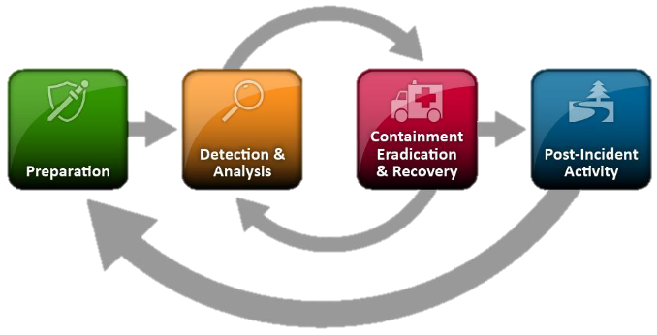
NIST IR Lifecycle

Slide 30
SANS vs NIST?
SANS Lifecycle | NIST Lifecycle
Preparation | Preparation
Identification | Detection and Analysis
Containment | Containment Eradication Recovery
Eradication
Recovery
Lessons Learned | Post-Incident Activities

Slide 31

Is that all?

Slide 32
What Else Do We Need?
IR works best with an IR Plan (IRP) – the ‘bible’ for what do do when it hits the fan.
IR Playbooks segment specific types of Incident Response based on threat type.
Notes:
It is proactive vs incident response is reactive

Slide 33
The Incident Response Plan
It Puts the Framework into Action or..
You get confused again.
Defines what happens in each checkpoint of the IR.
Also defines who is responsible.
Segments each section of the response process
Each part of the lifecycle serves a specific purpose.
Keeps Process in Order
Knowing what to do helps.

Slide 34


Slide 35
The Incident Response Playbook(s)
Tailored to specific threat types
Ransomware, Data Leakage, Account Compromise
Defines what happens in the process.
Specific instructions/tasks based on the threat type.
Can focus on tools specific to an IR Threat Type
May also be specific to your organization.
Should be stored in a centralized, shared, known location
Can’t use the playbooks if you don’t know where they are!

Slide 36
Now we’re done, right?

Slide 37


Slide 38

How can we make sure we’re ready?
Incident Response is NOT something that we set and forget until we need to activate it.
The IR Plan is something that needs to be tested and verified so all parties understand roles and responsibilities.

Slide 39
The IRP Verification Plan
Make sure you know where you stand.
The best time to read and understand the IRP is not in the middle of an incident.
Make sure it applies to your organization.
You’ve created the plan, make sure it is applicable and relevant to your organization.
Make sure the team knows their roles as well
You’re not the only part of the equation in an IR Plan.
Test, Verify, Improve, Adjust
Do annual Table Top Exercises (TTX) at minimum. Take lessons learned and improve incrementally.

Slide 40

Putting It All Together?
All these blend together to streamline Incident Response.

Slide 41
Putting It All Together?
03
IR Runbooks
The Guides
02
IR Playbooks
The Process
01
IR Plan
The Foundation

Slide 42
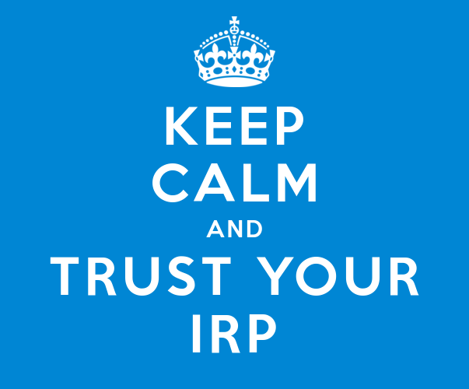

Slide 43





The Fusion Wheel: Integrating Security Functions
Threat Intelligence (TI)
Threat Hunting (TH)
Informs detection rules, enriches context, and feeds hunting and incident response efforts. Draws from OSINT, commercial feeds, and internal telemetry.
Detects unknown threats by establishing baselines and identifying anomalies ("knowing normal to find evil"). Leverages Sigma/YARA rules, Chainsaw log analysis, and MFT parsing.
Incident Response (IR)
Reverse Engineering (RE)
Executes playbooks based on identified threats, driven by both TI and Hunting outcomes. Performs investigations on impacted hosts to extract evidence.
Deconstructs malware artifacts, binaries, and scripts to feed intelligence and detection development. Supports incident response and root cause analysis.
Digital Forensics (DF)
Performs in-depth investigations on impacted hosts, extracting evidence to support incident response and reverse engineering efforts.
AI-powered automation amplifies each function—from extracting indicators to suggesting hunting hypotheses, accelerating malware analysis, and predicting attacker movements through behavioral modeling.
When these disciplines collaborate continuously rather than operate in silos, defensive capabilities mature exponentially, creating a force multiplier effect against sophisticated threats.

Slide 44
Other resources for further learning

Slide 45
Project Obsidian GitHub
Other 101 Sessions provided by the BlueTeam Village Project Obsidian Group:
https://github.com/blueteamvillage/Project-Obsidian-DC33

Slide 46
Platforms, Courses and Certs
The following courses can introduce you to Incident Response.
IT Masters/Charles Sturt - Information Security Incident Handling course (FREE!)
Antisyhon Training – Digital Forensics and Incident Response
Antisyhon Training – Cybersecurity Incident Commander

Slide 47

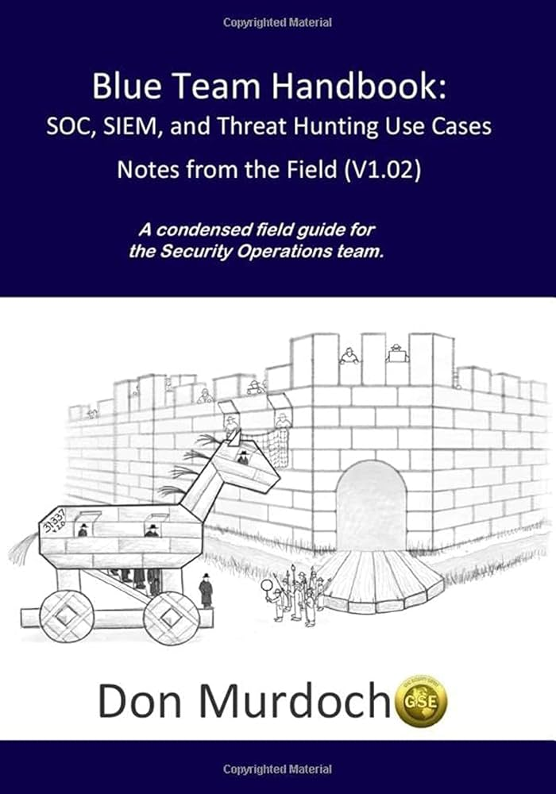
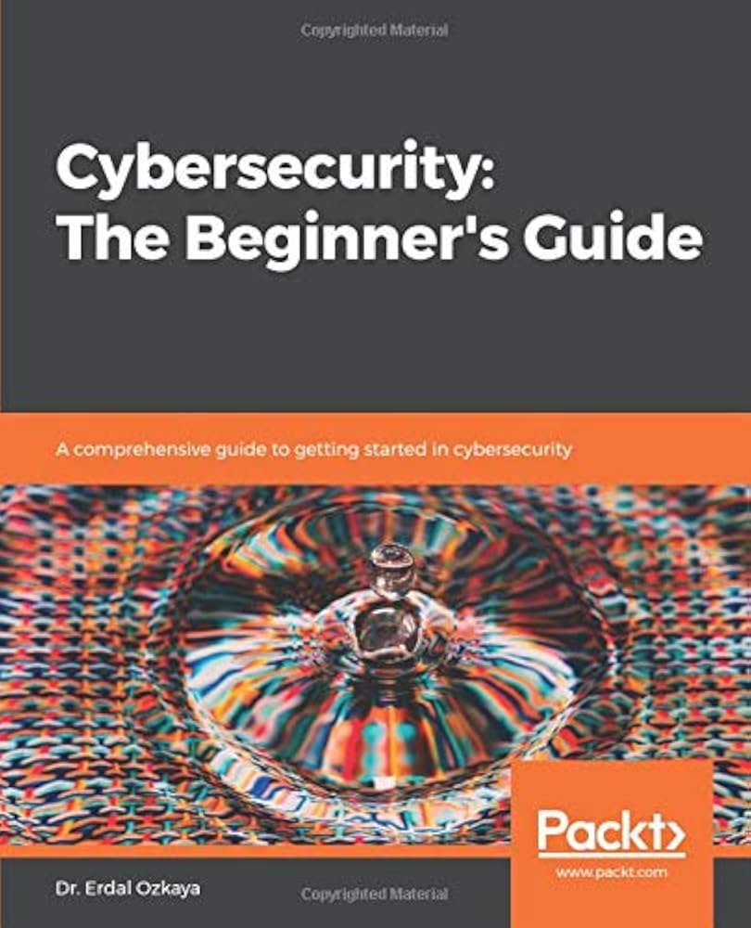
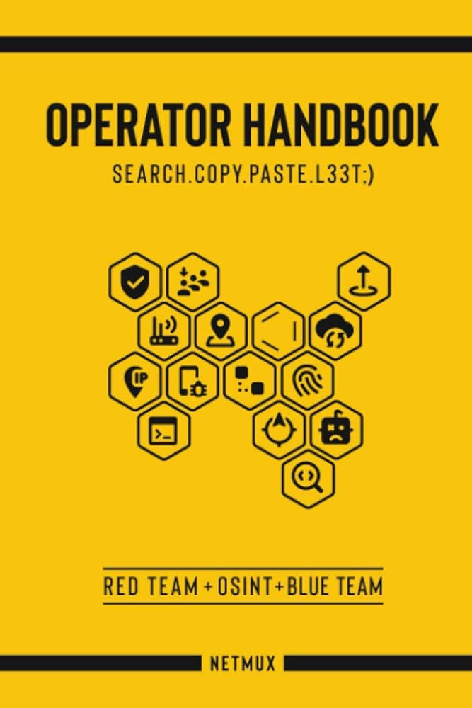
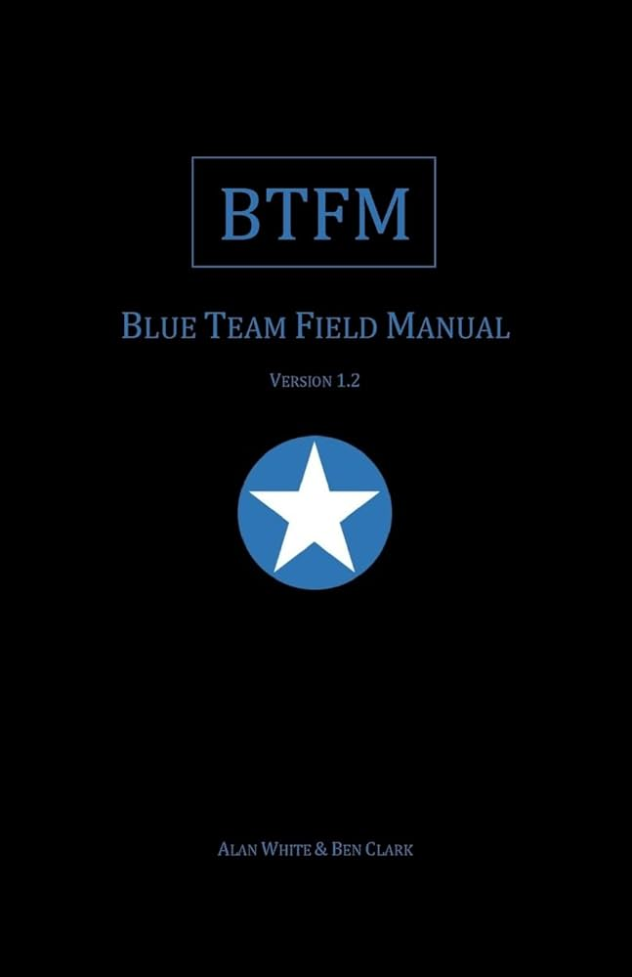
Books
Blue Team Handbook – Don Murdoch
Blue Team Handbook: Incident Response – Don Murdoch
Cybersecurity: The Beginner's Guide – Dr. Erdal Ozkaya
Operator Handbook – Joshua Picolet
Blue Team Field Manual – Alan White & Ben Clark

Slide 48
Jump-Start Your Incident Response
https://www.frsecure.com/resources/
https://www.gitlab.com/syntax-ir/playbooks
https://learn.microsoft.com/en-us/security/operations/incident-response-playbooks
https://www.github.com/socfortress/Playbooks
https://www.github.com/luduslibrum/awesome-playbooks

Slide 49
Resources
https://itmasters.edu.au/short-courses/information-security-incident/
https://github.com/okhosting/awesome-cyber-security
https://training.dfirdiva.com/
https://www.sans.org/white-papers/33901/

Slide 50

About the Presenter
Samunoske
Security Operations
Security Advocate
Security Trainer
Security Leader
Contact
www.ilovesec.com
samunoske@ilovesec.com

Slide 51

And finally…

